Slide 1
Analyzing how different features affect the popularity of a book
Vrinda Narayan (2018120)
Osheen Sachdev (2018059)
Ayush Goel (2018029)
Group- 32

Slide 2
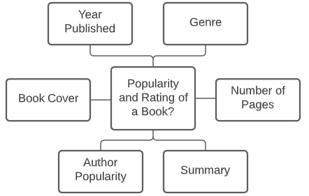
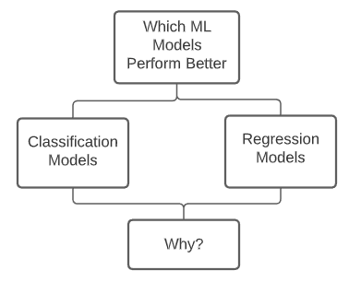
Motivation
In 2017, people in the U.S. 15 years and older spent an average of 16.8 minutes a day reading. This is down from 22.8 minutes in 2005.
We aim to identify which features contribute the most in deciding a book’s popularity.
Notes:
Vrinda

Slide 3
Literature Review (1)
Analyzing Social Book Reading Behavior on Goodreads and how it predicts Amazon Best Sellers
This research takes into account reading behaviours along with other baseline features like rating, reviews etc to analyse if a book will become an Amazon Bestseller within a month of being published.
Uses Goodreads user status posts to create features like number of status updates, time taken to finish the book etc.
Classification problem
Obtained an accuracy of 88.72 % (Logistic Regression)
Notes:
Osheen

Slide 4
Literature Review (2)
Success in books: predicting book sales before publication
The research takes into account the features from the author(Popularity), book(Genre, publishing month) and publisher.
Popularity of the author is estimated by the number of views on the wikipedia page of the author and the sales of previous books as reported on the bookscan website.
Regression problem: predicted the sales of the book
Employed a new machine learning model: Learning to place which outperformed the other learning methods for this task.
Notes:
Ayush

Slide 5
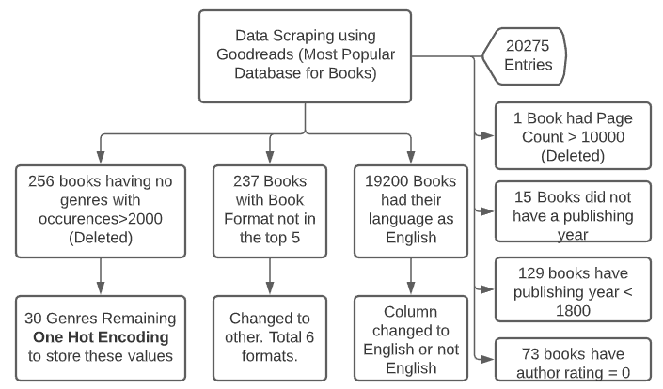
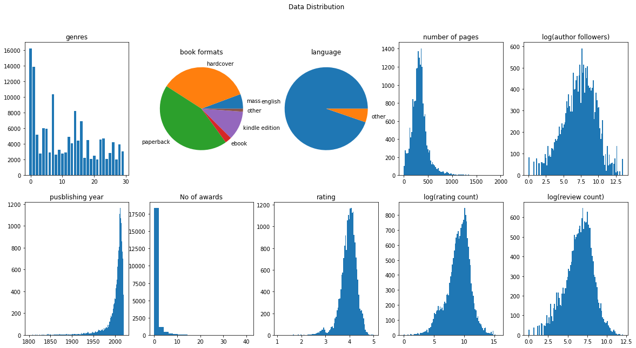
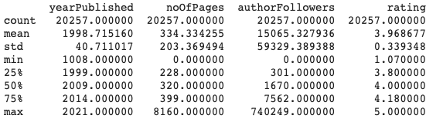
Data Scraping and Preprocessing
20% Test Set (5000 Entries)
5-Fold Cross Validation on remaining 80% data.
Notes:
Vrinda

Slide 6

Custom Metric
Ratings were concentrated around 3.7 to 4.3.
Imbalanced Regression Problem.
Define custom metric as given below
4. Penalize incorrect prediction points farther away from the mean.
Notes:
Osheen

Slide 7
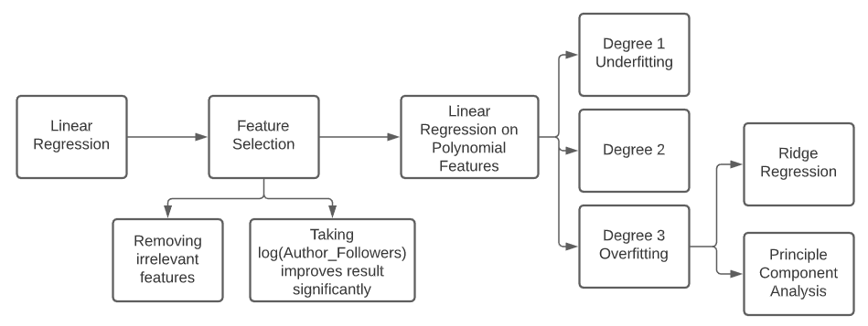
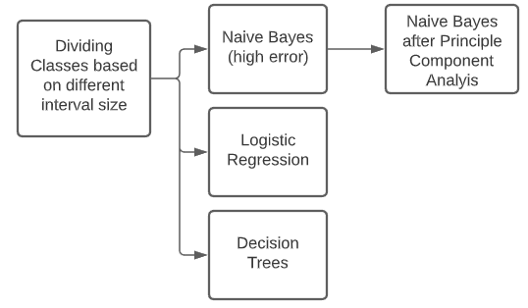
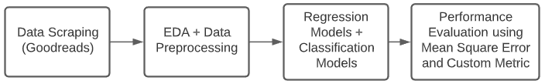
Methodology
Classification Methodology
Regression Methodology
AdaBoost
Bagging
XgBoost
Notes:
Ayush

Slide 8
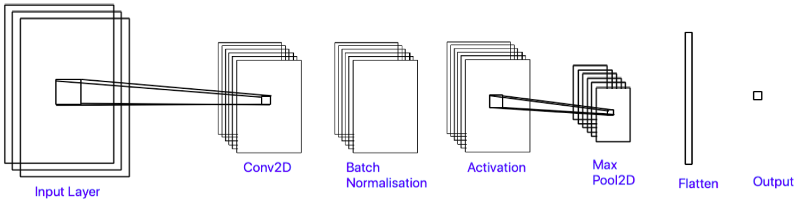
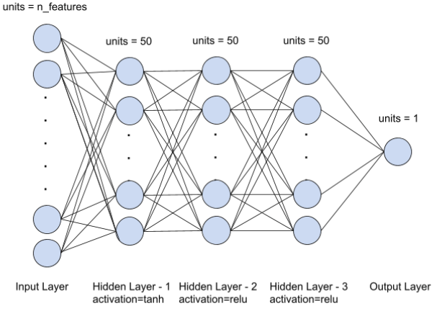
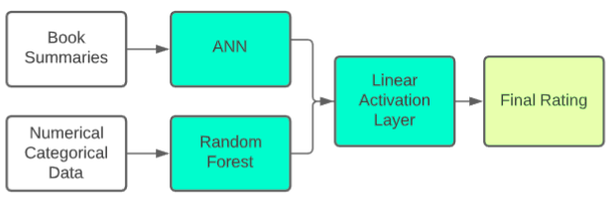
Methodology (2)
Book Cover:
ANN
CNN
Book Summary:
ANN
ANN + Regularization
Doc2Vec + Random Forest
Final Model Architecture
Book Summary NN Architecture
Notes:
Vrinda

Slide 9
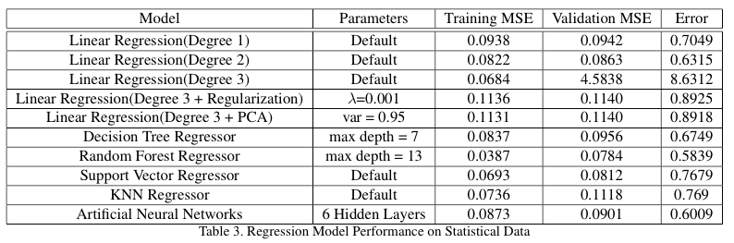
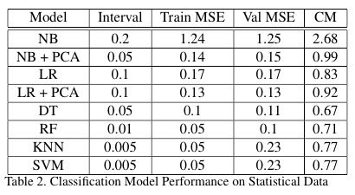
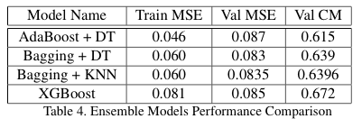
Results
Results of models trained on numerical data
Notes:
Osheen

Slide 10
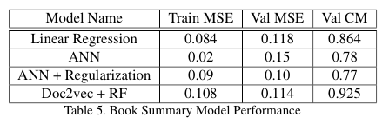
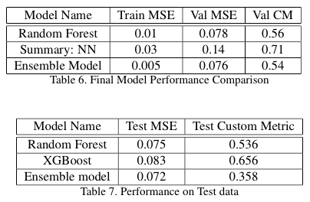
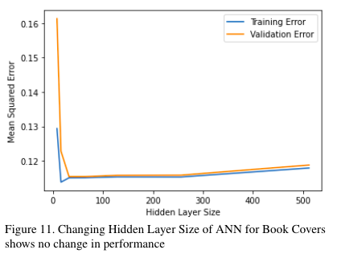
Results (2)
The ensemble model from combining the Random forest on numerical data and ANN on summary is giving a lower validation MSE and Custom Metric performance
Notes:
Ayush

Slide 11
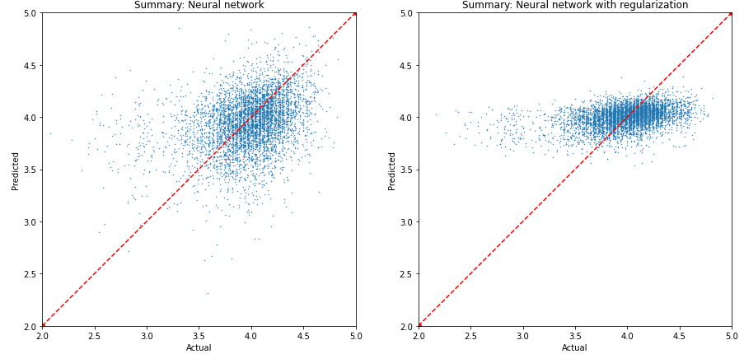
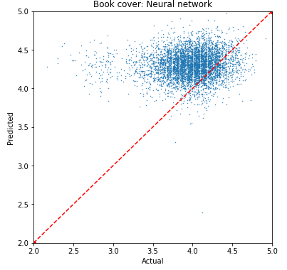
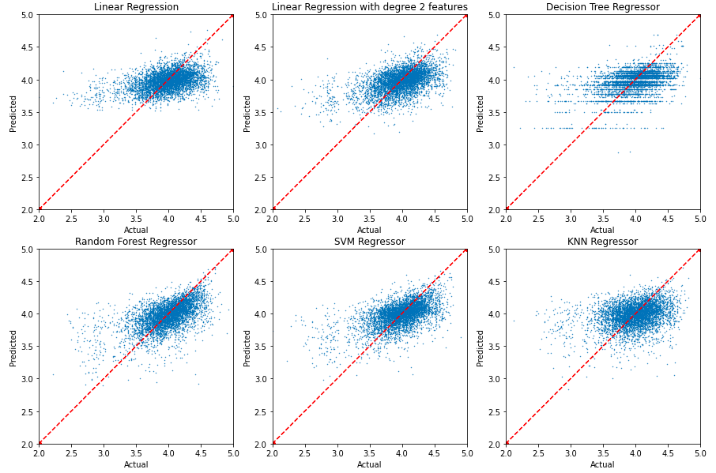
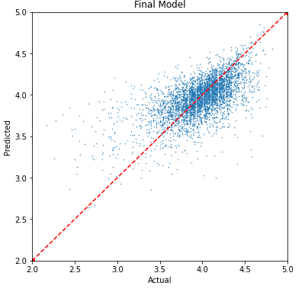
Results (3)
Actual vs Predicted values : Summary
Actual vs Predicted values : Book Cover
Actual vs Predicted values for models on numerical data
Actual vs Predicted values for the final model on test data
Notes:
Osheen

Slide 12
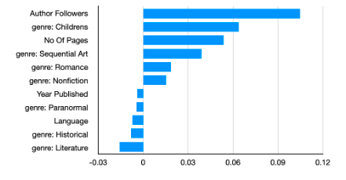
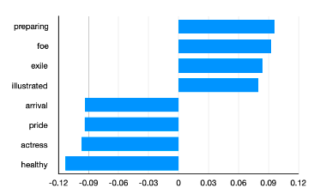
Results (4)
Most Significant Features with weights
Most Significant Words in Summary with weights
Notes:
Vrinda

Slide 13
Individual Contribution
All members contributed equally to the project.

